Slide 1

Genetic models applied to polyploid species
Marcelo Mollinari
mmollin@ncsu.edu
PBG seminar – Feb 22, 2022 – Cornell University

Slide 2






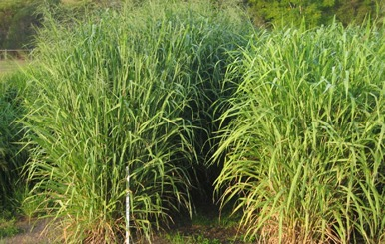


Polyploids
Polyploids are organisms that have multiple copies of the complete set of chromosomes. This multiplicity imposes numerous challenges to genomic analysis and subsequent applications in practical breeding.
Notes:
No preferential pairing
Only bivalents are formed during the meiosis
No double reduction

Slide 3
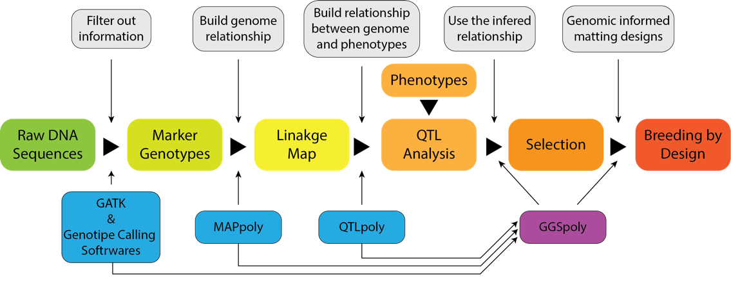
What is our objective?
Develop computational tools for the whole pipeline data analysis
MAPpoly: R package for constructing a complete linkage map for 2X, 4X, 6X, 8X.
QTLpoly: R package for QTL mapping in full-sib families for 2X, 4X, 6X, 8X
GGSpoly: Working closely with polyploid breeders, we are implementing GGSpoly: a user-friendly computational tool to assist breeders in making long and short-term breeding decisions based on collected and learned information about their breeding populations.
https://sweetpotatogenomics.cals.ncsu.edu/

Slide 4
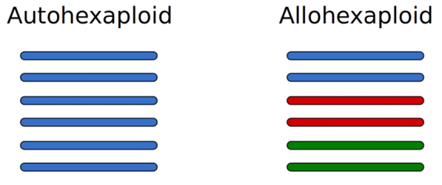
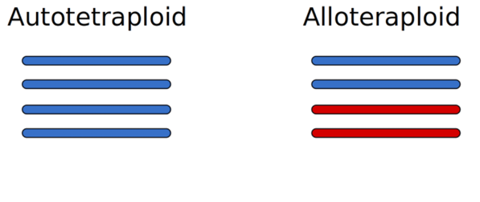
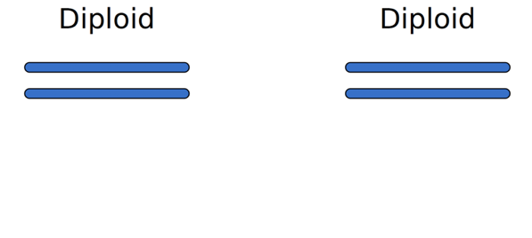
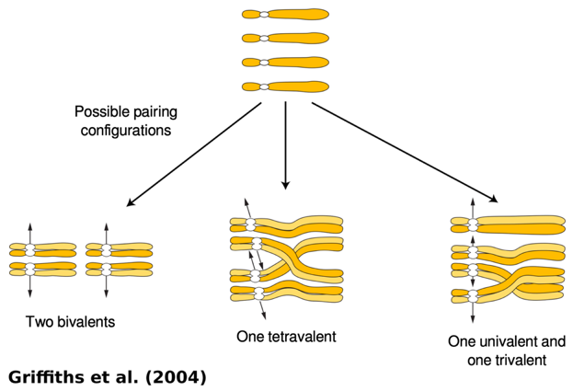


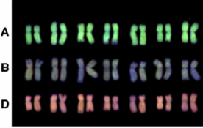
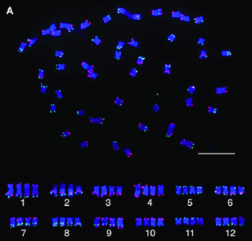
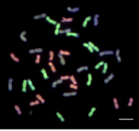
Polyploid species
Meiotic pairing in autotetraploids
Multiple sets have the same origin
Multiple sets have different origins
Allohexaploid wheat
Autotetraploid potato
Braz et al., 2018
Zhang et al., 2013
Notes:
No preferential pairing
Only bivalents are formed during the meiosis
No double reduction

Slide 5
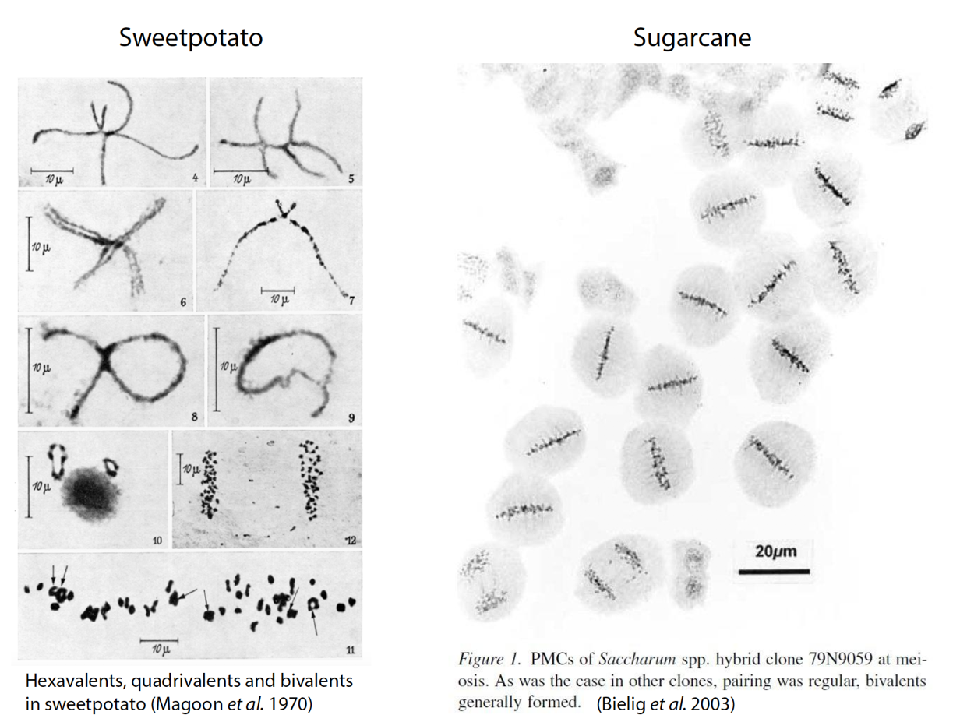
Meiotic Pairing in autopolyploids

Slide 6
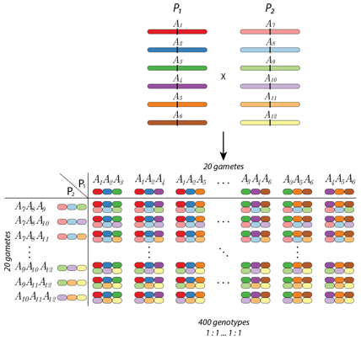
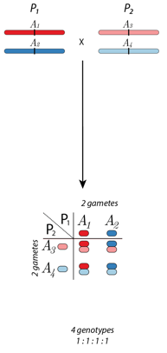
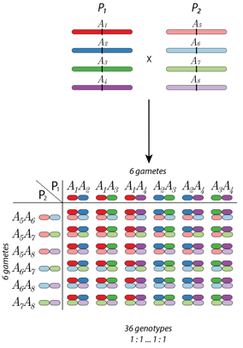
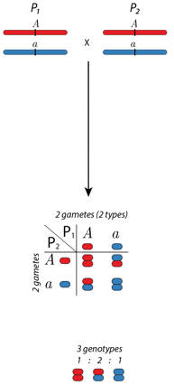
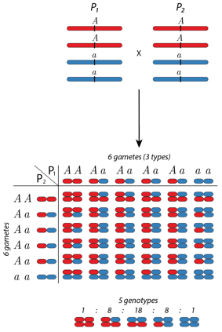
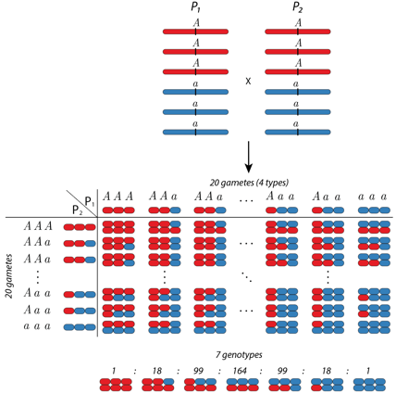
Segregation in polyploids*
Hexaploid
Diploid
Tetraploid
Multiallelic
Biallelic
*random pairing and no double reduction

Slide 7
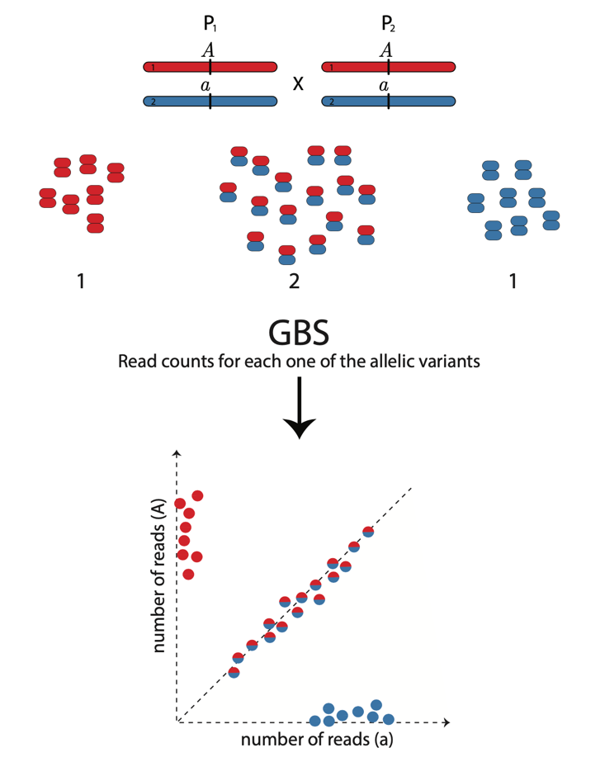
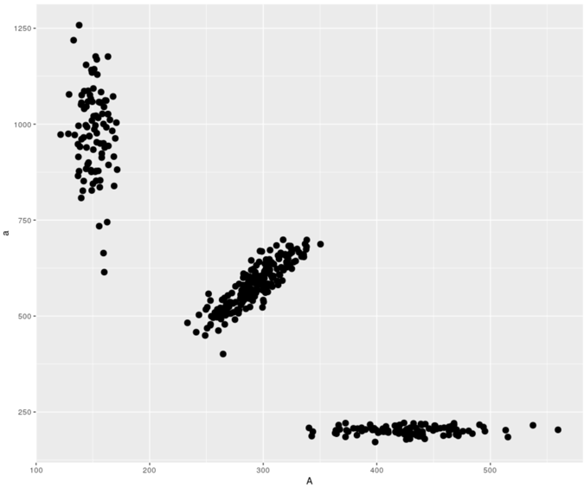
Genotype calling in diploids

Slide 8
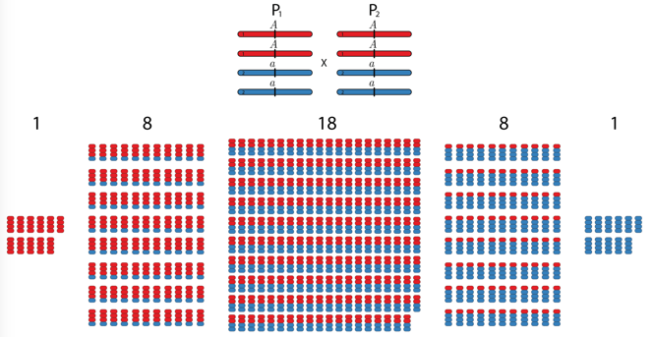
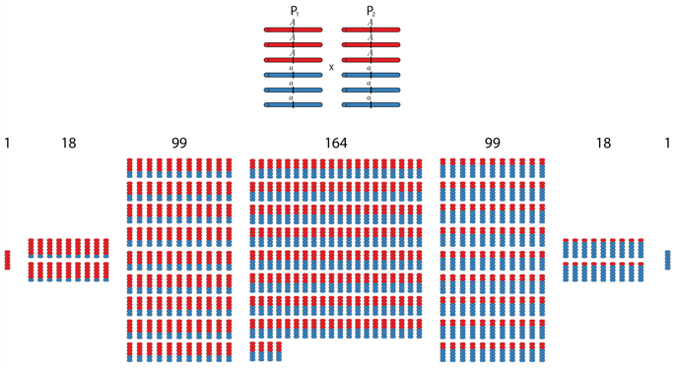
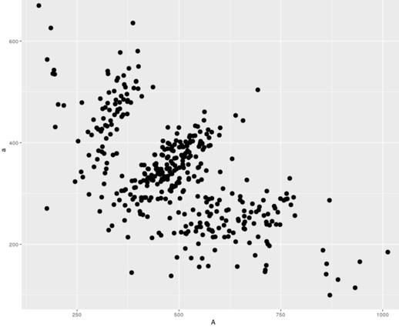
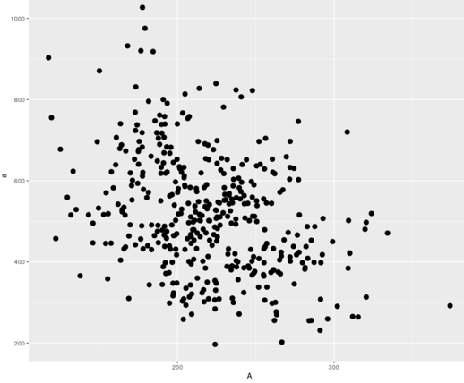
Genotype calling in polyploids
Tetraploid
Hexaploid

Slide 9
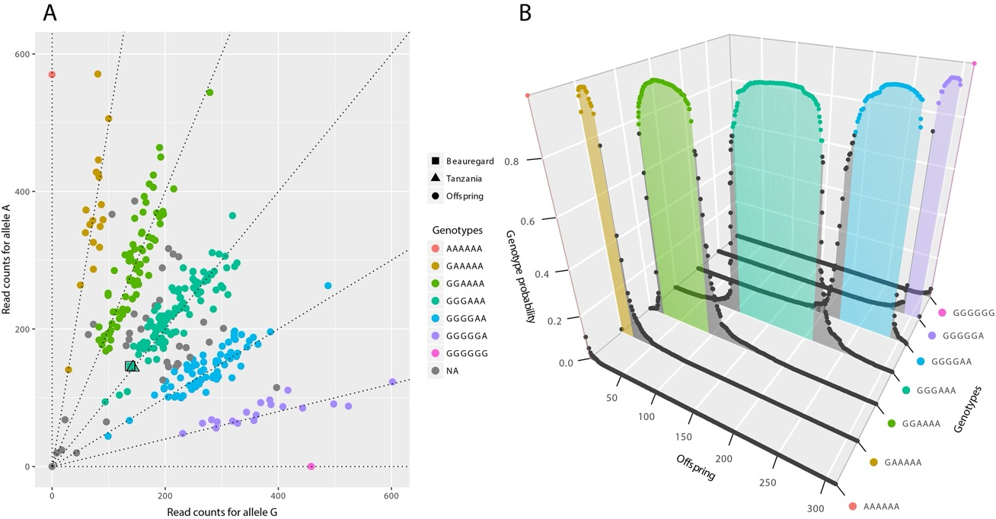
Genotyping Calling using SuperMASSA Dosage calling including the probability distribution of the genotypes
Beauregard: 3 doses
Tanzania: 3 doses

Slide 10
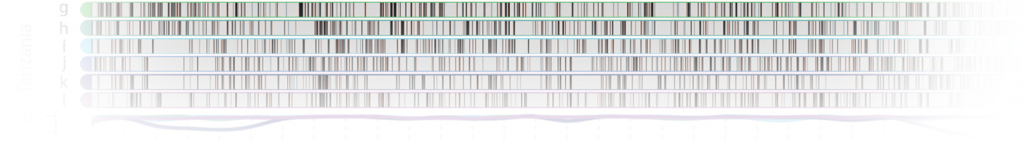
Phasing and mapping The allelic transmission model
Linkage Analysis and Haplotype Phasing in Experimental Autopolyploid Populations with High Ploidy Level Using Hidden Markov Models. Mollinari and Garcia (2019) doi:10.1534/g3.119.400378

Slide 11
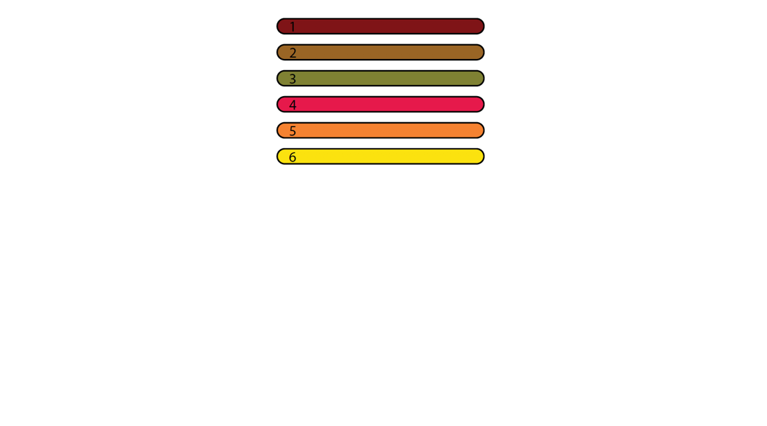
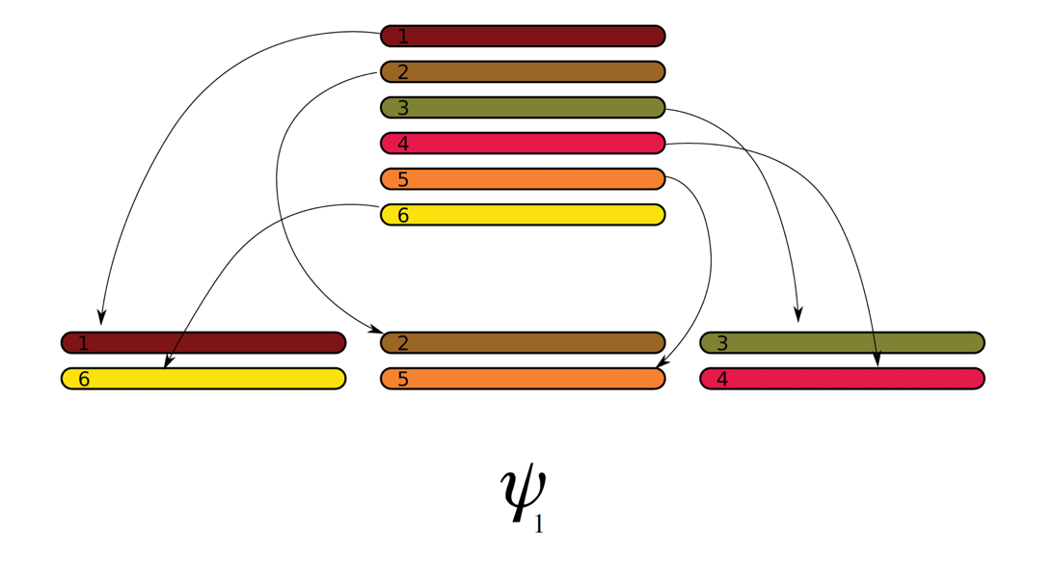
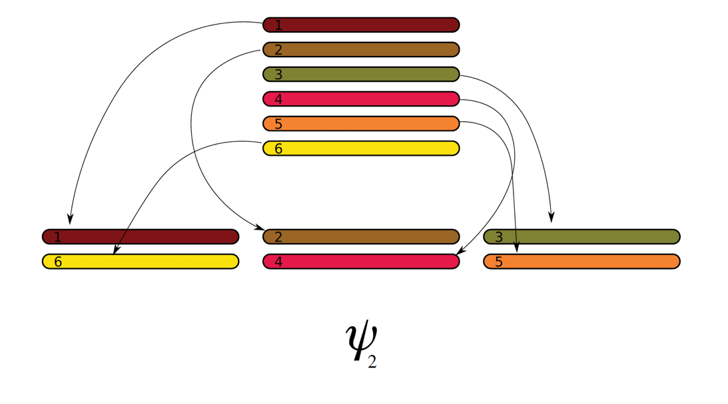
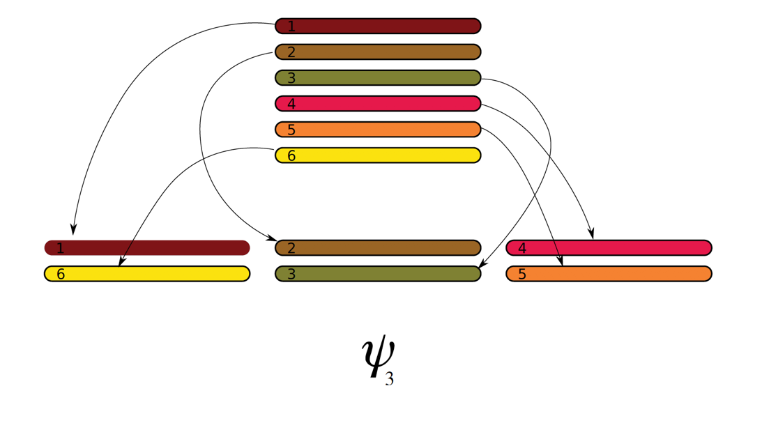
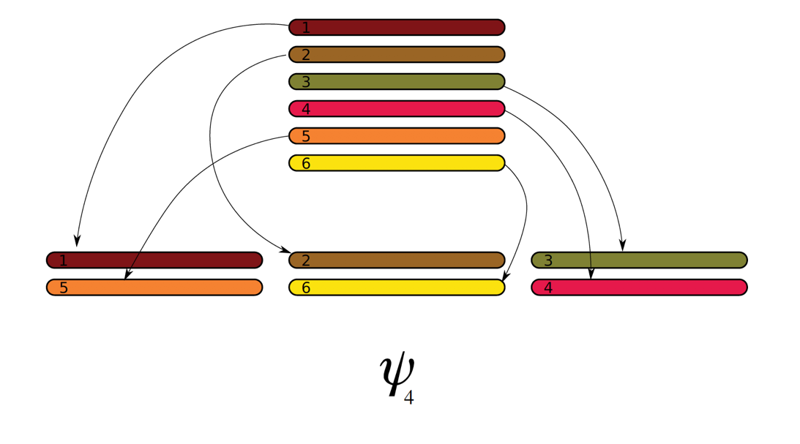
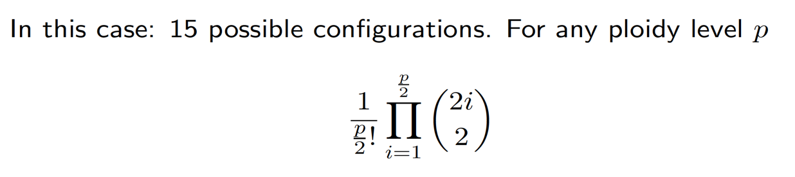
Gamete formation in polyploids*
*no double reduction

Slide 12
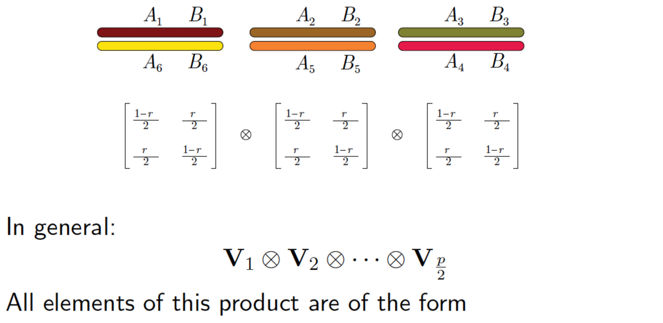
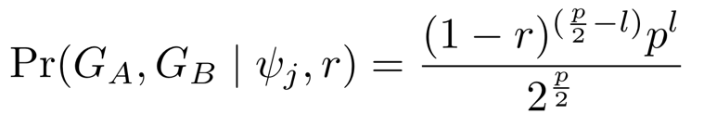
Expected gametic frequency given a bivalent configuration
l : known number of recombinant bivalents between loci A and B

Slide 13
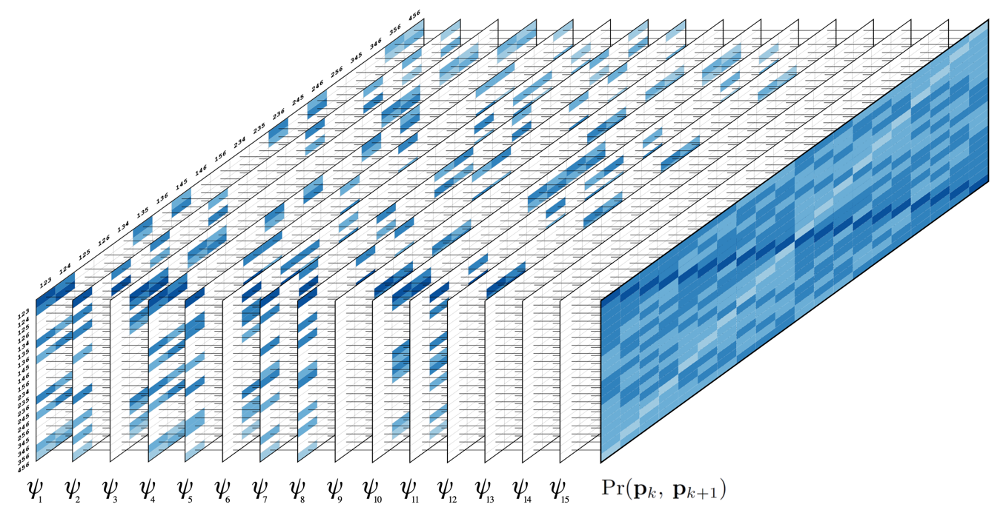
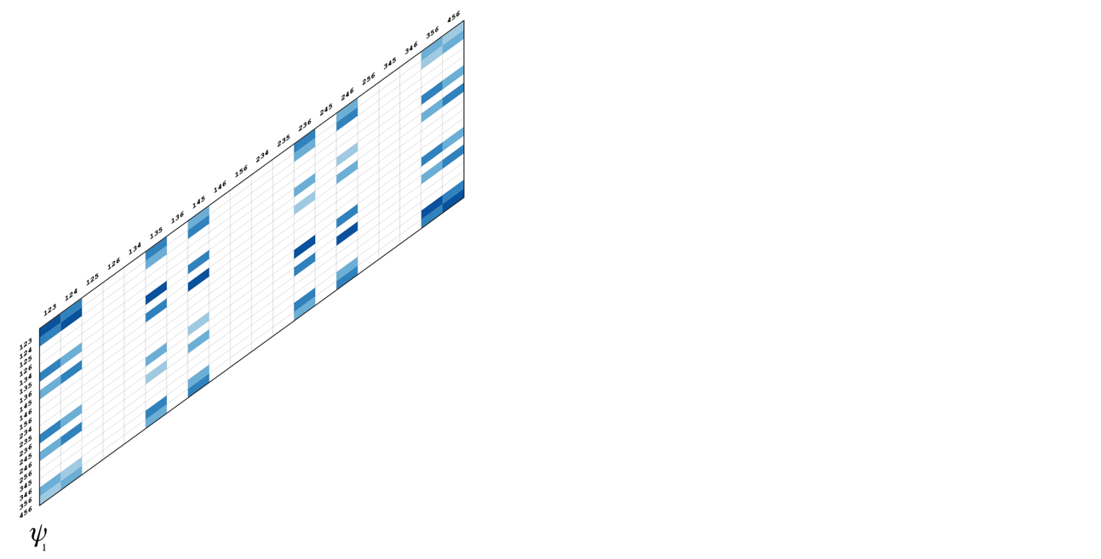

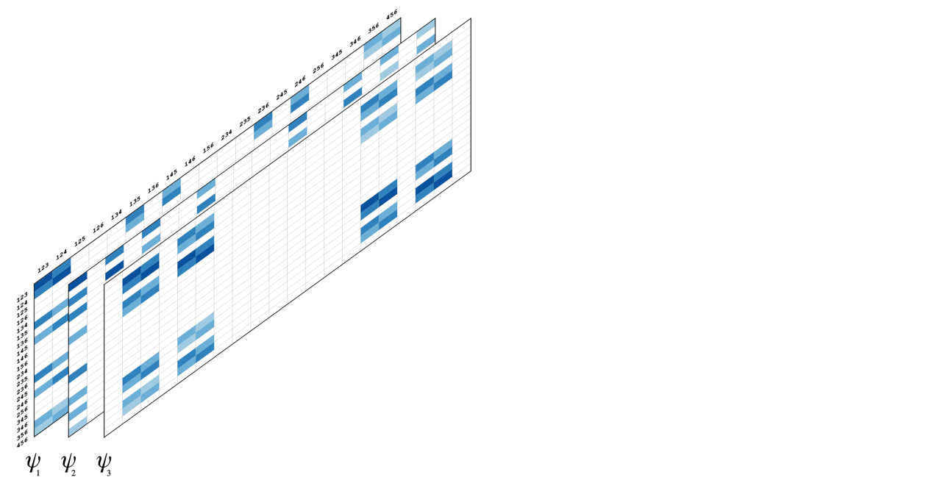
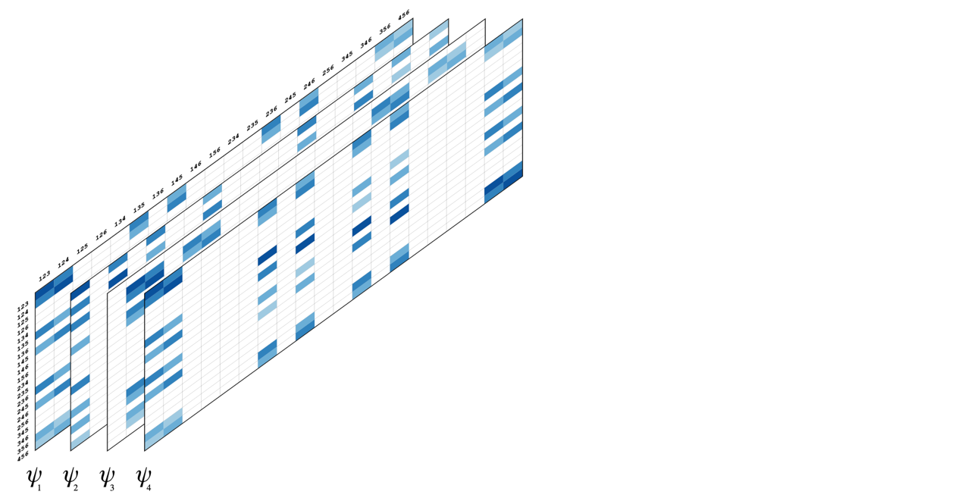
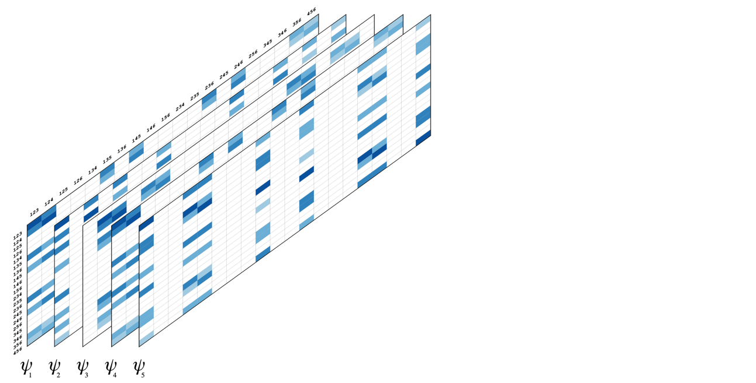
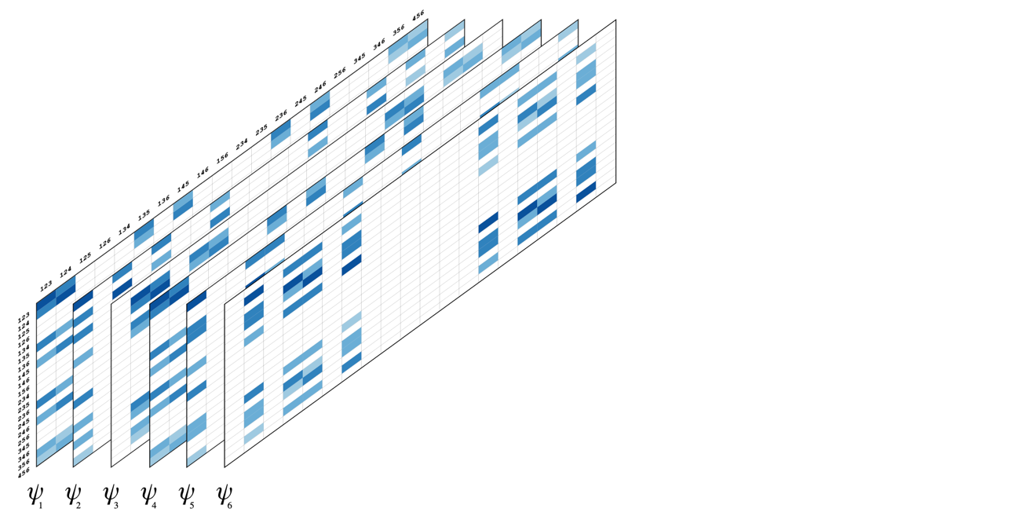
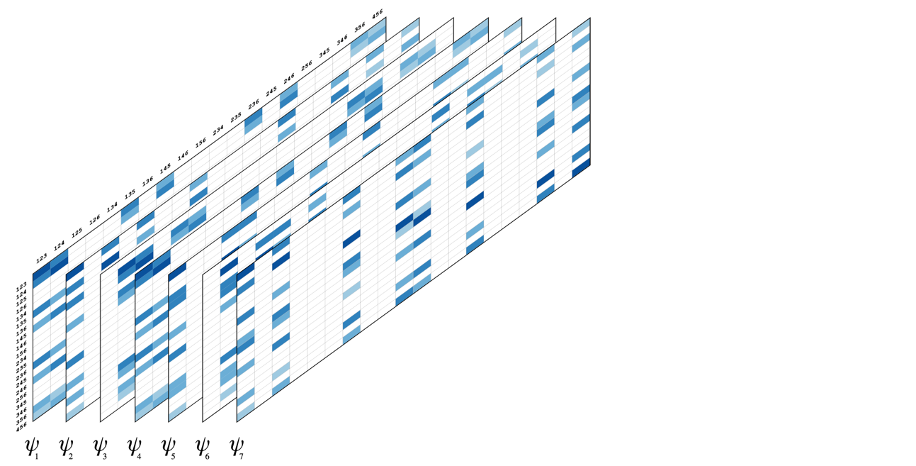
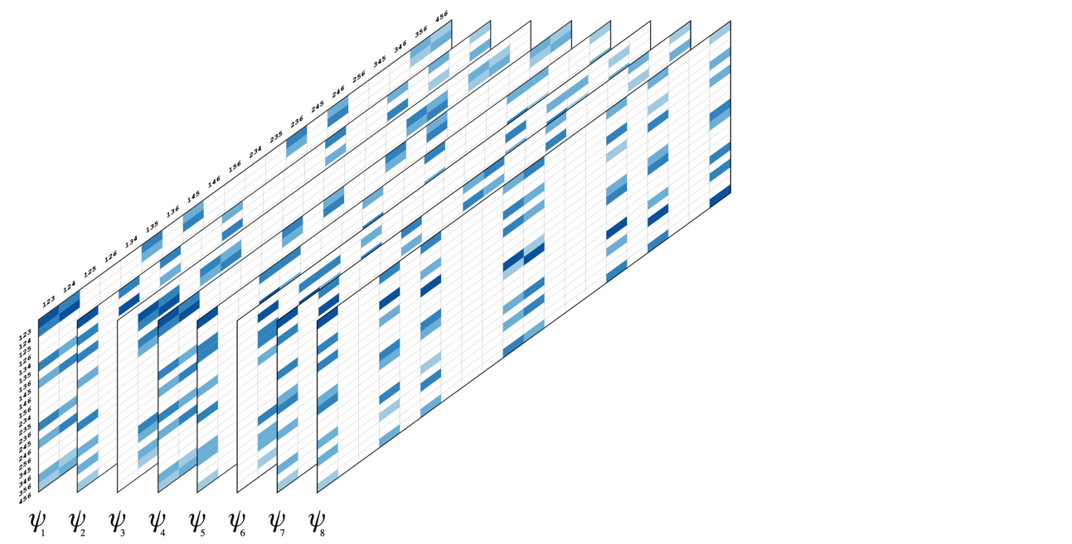
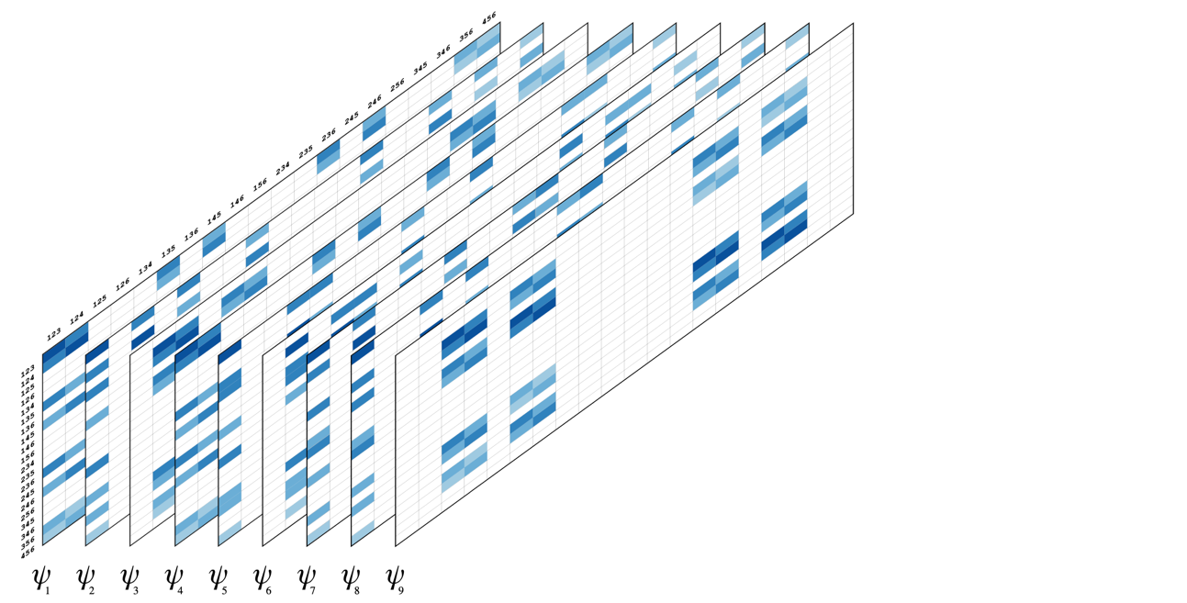
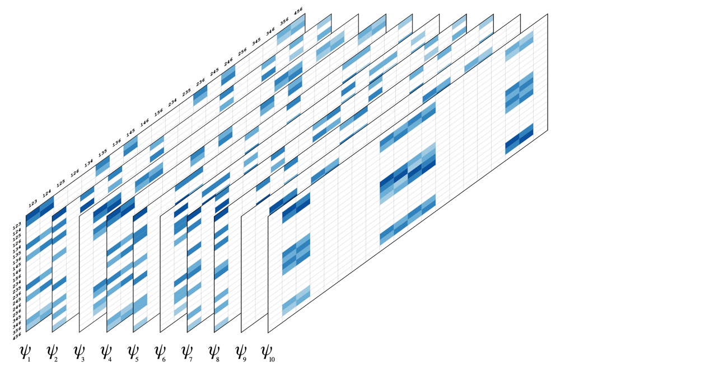
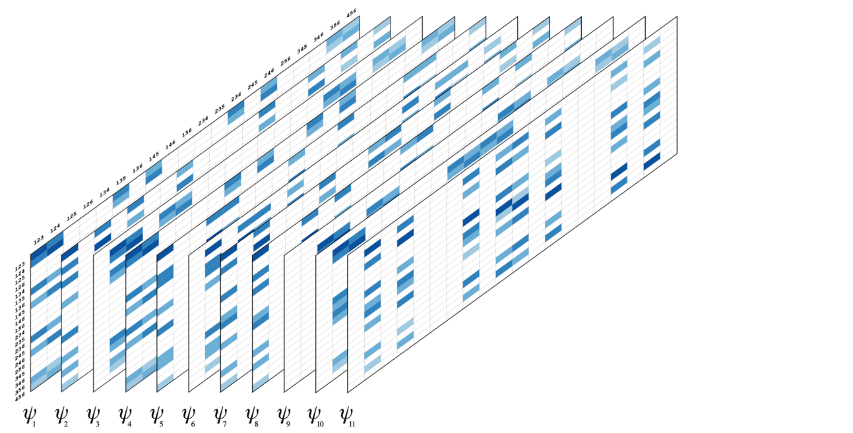
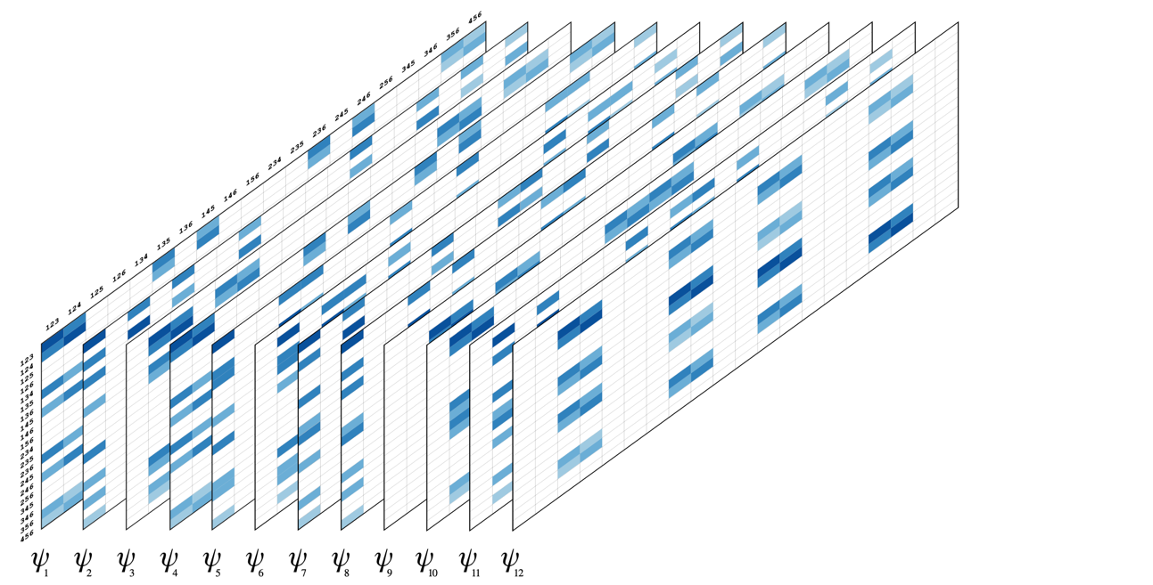
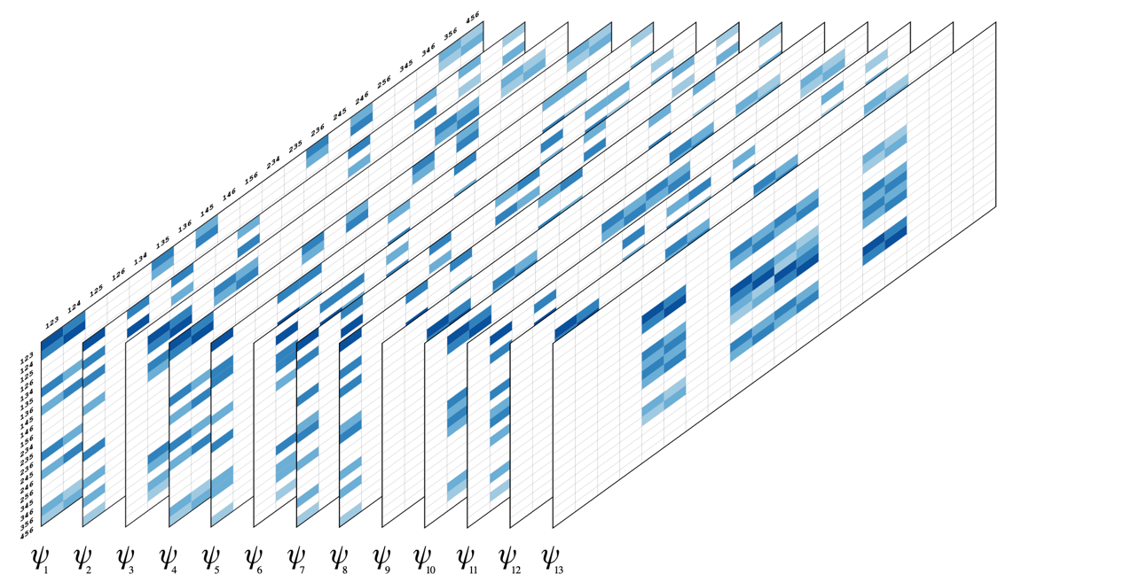
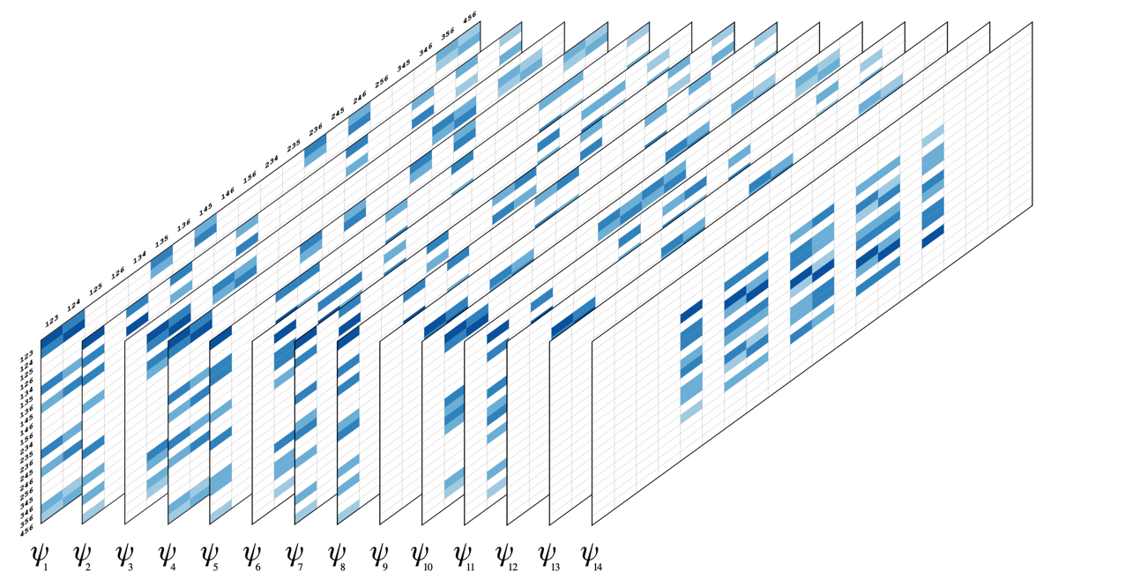
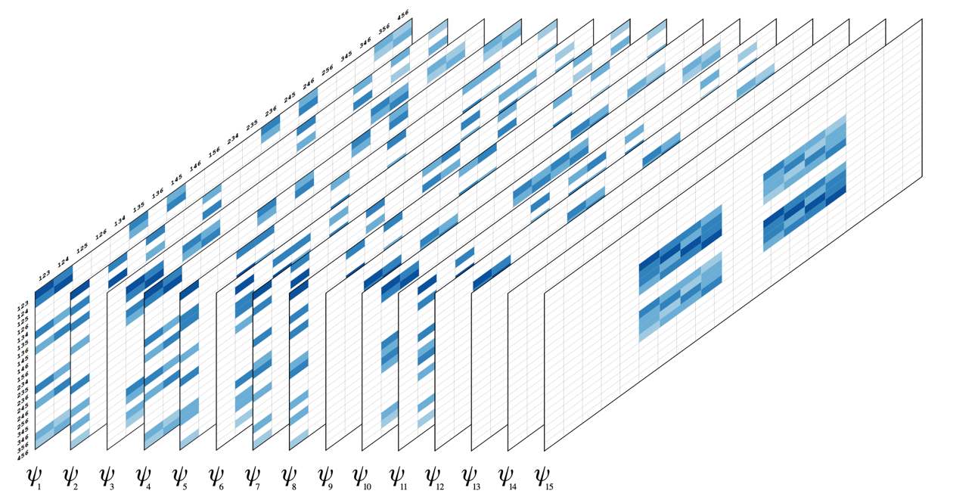
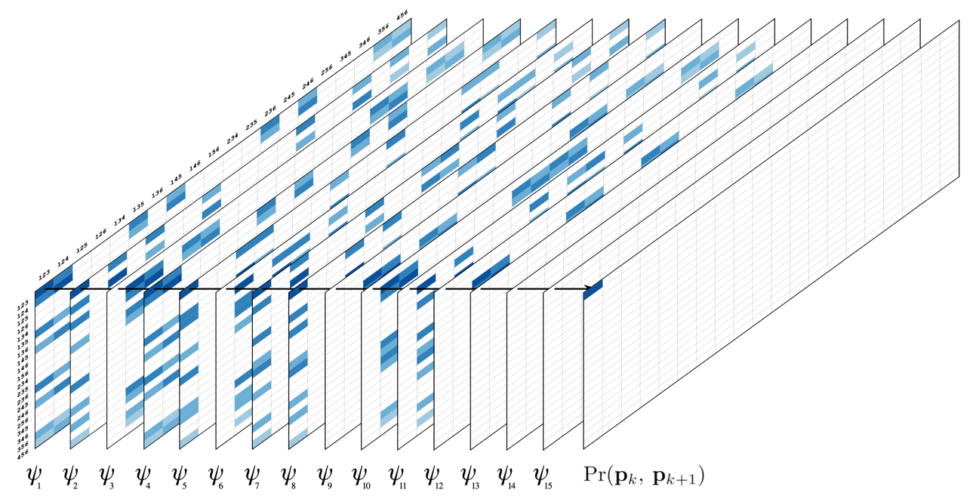
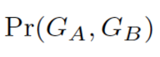
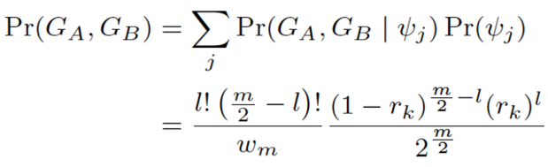
Unconditional gametic probability
Mollinari and Garcia (2019)

Slide 14

Recombination Fraction – assessing linkage phases
Pairwise MLE of r are used to group markers into linkage groups and order markers within each linkage group using optimization algorithms such as MDS
Given a sequence of ordered markers, it is possible to extend the idea of comparing likelihoods of competing linkage phases throughout multiple markers

Slide 15


Haplotype phasing in polyploids
Disposition of allelic variants in the homologs in a homology group
dosages

Slide 16

Multilocus linkage analysis in polyploids
where r_{k} is the recombination frequency between loci k and k+1, p is the ploidy level and l is the number of recombinant events between k and k+1.
Leach et al. (2010) doi:10.1073/pnas.0908477107
Mollinari and Garcia (2019) doi:10.1534/g3.119.400378

Slide 17


Hidden Markov Model - HMM
Individual 64:
Rabiner (1989): https://doi.org/10.1109/5.18626

Slide 18

Hidden Markov Model - HMM
Tetraploid example, one individual, 15 markers
1 1 1 3 1 1 2 2 0 1 2 1 1 0 1

Slide 19



Biparental Population - BT
Beauregard x Tanzania
315 individuals
GBS – GBSpoly protocol (Bode Olukolu – U Tennessee)
Two reference genomes I. trifida and I. triloba (Zhangjun Fei’s group – BTI Cornell)
X
Beauregard
Tanzania

Slide 20


Biparental Population - BT

Slide 21

Ordering with MDS – 15 linkage groups
1 2 3 4 5 6 7 8 9 10 11 12 13 14 15
Numbers indicate the associated chromosomes in I. trifida and I. triloba reference genomes

Slide 22

Sweetpotato genetic map
Mollinari et al. (2020)
doi:10.1534/g3.119.400620

Slide 23

Sweetpotato genetic map

Slide 24


Probabilistic haplotype reconstruction
When assuming a prior probability distribution of the genotypes, multilocus strategies can improve the quality of the inferred haplotypes
Tetraploid potato

Slide 25


Probabilistic haplotype reconstruction
Hexaploid sweetpotato

Slide 26



MAPpoly – R package to construct multipoint genetic maps in polyploids
stable: https://CRAN.R-project.org/package=mappoly
development: https://github.com/mmollina/MAPpoly

Slide 27


Genetic mapping – Linkage group 12 – 2661 SNPs
Interactive version: https://gt4sp-genetic-map.shinyapps.io/bt_map/

Slide 28


Haplotype reconstruction in the offspring
https://gt4sp-genetic-map.shinyapps.io/offspring_haplotype_BT_population/

Slide 29

Number of homologs involved in recombination chains

Slide 30

Preferential pairing profiles: Sweetpotato is vastly autohexaploid

Slide 31





QTL studies

Slide 32




Analysis in multiple inter-connected sweetpotato families
Complete genetic map for BT, TB, and NKB
Schematic representation of three interconnected populations: BT, TB, and NKB
Example of haplotyping in chromosome 15: Beauregard, Tanzania and New Kawogo
Notes:
Since we don’t have the MDP data we are using our three biparental populations to test our model.

Slide 33



User friendly tools
VIEWpoly: Interactively explore and select QTL regions, find candidate genes, find favorable haplotypes, dosage effects, list breeding values, and QTL information.
Notes:
ViewPoly is a shiny app and R package for visualizing and exploring results from polyploid computational tools using an interactive graphical user interface. The package allows users to directly upload output files from polyploid tool, (polymapR, MAPpoly, polyqtlR, QTLpoly, diaQTL) and genomic assembly and annotation files. ViewPoly uses Shiny, golem, ggplot, Plotly, and JBrowseR libraries to graphically display the SNP dosages in parentals and offspring, and their respective haplotypes in the genetic map. It also shows the results of QTL analysis, including confidence intervals, estimated effects, and their corresponding genomic positions, which can be interactively explored with a genome browser, allowing the search for candidate genes. It also provides features to download specific information into comprehensive tables for further analysis and presentation.

Slide 34
Perspectives
Specific Objectives
Continue to bridge the gap between the complex polyploid genetics and practical breeding
Implementing user friendly computational tools to help breeders make the best use of their data.
Such tool can assist them to make the short and long-term breeding decisions based on the collected and learnt information about their breeding populations for different breeding objectives
Some objectives: which individuals to select, who to mate to who; and long-term breeding strategy, which may be informed through targeted forward simulation exercises.
In order to improve this objectives, which sometimes are crop-specific, we need to have a direct communication with polyploid breeders and discuss their needs in terms of computational tools
Overarching objective
Use the inference of genome inheritance (haplotype transmission) through pedigrees, elucidating the genetic relationship between genome segregations and trait phenotypes in terms of QTL of founders’ alleles.

Slide 35













Acknowledgements
Gabriel Gesteira, Zhao-Bang Zeng, Craig Yencho
Guilherme Pereira
Antonio Augusto Franco Garcia
Bode Olukolu
Shan Wu, Zhangjun Fei
Dorcus C. Gemenet

Slide 36
References
Haldane, J. Theoretical Genetics of Autopolyploids. J. Genet. 22, 359–372 (1930).
Mather, K. Reductional and equational separation of the chromosomes in bivalents and multivalents. J. Genet. 30, 53–78 (1935).
Mather, K. Segregation and linkage in autotetraploids. J. Genet. 32, 287–314 (1936).
Mather, K. The measurement of linkage in heredity. (1938).
Fisher, R. A. The theory of linkage in polysomic inheritance. Philos. Trans. R. Soc. Lond. B. Biol. Sci. 233, 55–87 (1947).
Lander, E. S. & Green, P. Construction of multilocus genetic linkage maps in humans. Proc. Natl. Acad. Sci. U. S. A. 84, 2363–2367 (1987).
Rabiner, L. R. A tutorial on hidden Markov models and selected applications in speech recognition. Proc. IEEE 77, 257–286 (1989).
Ripol, M. I., Churchill, G. A., Silva, J. A. G. Da & Sorrells, M. Statistical aspects of genetic mapping in autopolyploids. Gene 235, 31–41 (1999).
Luo, Z. W., Zhang, R. M. & Kearsey, M. J. Theoretical basis for genetic linkage analysis in autotetraploid species. Proc. Natl. Acad. Sci. U. S. A. 101, 7040–7045 (2004).
Leach, L. J., Wang, L., Kearsey, M. J. & Luo, Z. Multilocus tetrasomic linkage analysis using hidden Markov chain model. Proc. Natl. Acad. Sci. U. S. A. 107, 4270–4274 (2010).
Hackett, C. a., McLean, K. & Bryan, G. J. Linkage Analysis and QTL Mapping Using SNP Dosage Data in a Tetraploid Potato Mapping Population. PLoS One 8, (2013).
Zheng, C. et al. Probabilistic Multilocus Haplotype Reconstruction in Outcrossing Tetraploids. Genetics 203, 119–131 (2016).
Bourke, P. M. Genetic mapping in polyploids. (Wageningen University, 2018).
Mollinari, M. & Garcia, A. A. F. Linkage Analysis and Haplotype Phasing in Experimental Autopolyploid Populations with High Ploidy Level Using Hidden Markov Models. G3 9, 3297–3314 (2019).

